Slide 1
Javascript Intro
let's rock the DOM

Slide 2
The History
Conceived as LiveScript, was released by Netscape and Sun Microsystems in 1995.
Later included in Netscape 2.0 with the name of Javascript
Microsoft use it as base of JScript for IE 3.0
Is an implementation of ECMAscript (ecmascript.org), which defines the specification standard of the code.
Latest EMACscript version is 6.

Slide 3
Usage of Javascript
Create rich and powerful webapps (gmail)
Automate tasks on Windows desktop (using Windows Scripting Host)
Extensions for desktop applications (Firefox, Fiddler)
HTML5 has extensive usage of Javascript
Browser extensions

Slide 4
....
RIA apps (Adobe Air) that run on your desktop
nodejs, an Event Driven, non-blocking platform that runs on top of the Google Chrome’s Javascript Engine (V8)
Javascript based SDK for mobile development (phonegap, titanium, ionic)
Interacting with a MongoDB database you use JS to create JSON objects

Slide 5
What's and what's not Javascript
Scripting / Programming language
Is an implementation of EMACscript, latest development is version 6 (ES6, also called Javascript 2015)
Runs on the Client side
Different than Java
Designed to add interactivity to HTML pages
Interpreted
Free
Some browsers doesn't supports it

Slide 6
Coding Javascript for the Web
the basics

Slide 7
What can Javascript Do?
JavaScript gives HTML designers a programming tool
JavaScript can react to events
JavaScript can manipulate HTML elements
JavaScript can be used to detect the visitor's browser
JavaScript can be used to create cookies

Slide 8
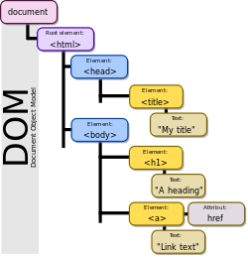
The DOM
Document Object Model

Slide 9
The DOM, Document Object Model
Is a cross-platform and language-independent convention for representing and interacting with objects in HTML, XHTML and XML documents.Objects in the DOM tree may be addressed and manipulated by using methods on the objects.
Tree representation of the elements in the HTML

Slide 10
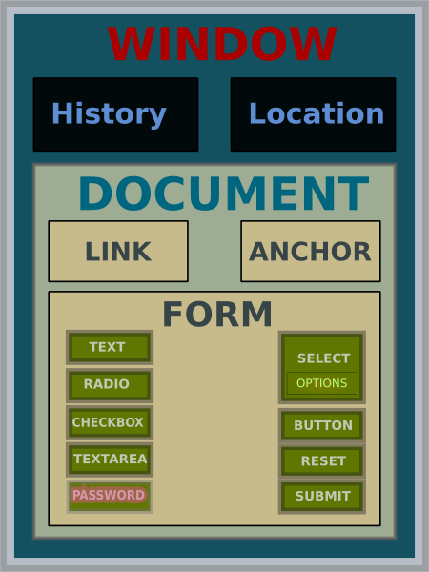

Slide 11
DOM manipulation - basic Javascript functions
document
getElementById
getElementByClassName
getElementByName
querySelector
querySelectorAll
write
appendChild
window
onload
onresize

Slide 12
Coding with Javascript
Is case sensitive
JavaScript code is a sequence of JavaScript statements.
Each statement is executed by the browser in the sequence they are written.
Use semi-colon (;) to finish each statements
Code can be embed in an HTML document or in an external .js file linked to the HTML document.
Classes are available only on JS 2015

Slide 13
Use the <script> tag
Is used to embed javascript into the HTML
3 ways to do it
In the head section of the HTML
From a javascript file, usually of .js extension
Inline
Is recommended to include any js file before the </body> tag

Slide 14
The Javascript Language
code convention:
https://github.com/dotcreek/javascript

Slide 15
Variables and Scopes
Scope is the set of variables, objects, and functions you have access to.
Variables are loosely typed, that means you don’t need to declare its type: ie:
userName = “Bladimir”;
Scope
Local Scope: Variables declared with “var” inside a function.
Global: Variables declared with “var” keyword at the root level of the script
Automatic Global: Variables declared without the “var” keyword inside or outside a method.

Slide 16
more about Variables..
In HTML, the global scope is the window object: All global variables belong to the window object.
The lifetime of a JavaScript variable starts when it is declared.
Local variables are deleted when the function is completed.
Global variables are deleted when you close the page.
Function arguments (parameters) work as local variables inside functions

Slide 17
Functions
There are 2 types:
Function Expressions
// anonymous function expression var anonymous = function() { return true; }; // named function expression var named = function named() { return true; }; // immediately-invoked function expression (IIFE) (function() { console.log('Welcome to the Internet. Please follow me.'); })();
Function Declaration
function Identifier ( FormalParameterListopt ) { FunctionBody }

Slide 18
Functions
A Function Declaration defines a named function variable without requiring variable assignment.
A Function Expression defines a function as a part of a larger expression syntax (typically a variable assignment ).
Functions expressions are loaded once the interpreter pass over the code, on the other hand Functions declaration are loaded during the parsing of the script.

Slide 19
Events
HTML events are "things" that happen to HTML elements.
When JavaScript is used in HTML pages, JavaScript can "react" on these events.
An HTML event can be something the browser does, or something a user does.
An HTML web page has finished loading
An HTML input field was changed
An HTML button was clicked

Slide 20
Some HTML Events
Event | Description
onchange | An HTML element has been changed
onclick | The user clicks an HTML element
onmouseover | The user moves the mouse over an HTML element
onmouseout | The user moves the mouse away from an HTML element
onkeydown | The user pushes a keyboard key
onload | The browser has finished loading the page
See all the list: http://www.w3schools.com/jsref/dom_obj_event.asp

Slide 21
Event Example
<button onclick='getElementById("demo").innerHTML=Date()'>The time is?</button>

Slide 22
Example
<!DOCTYPE html>
<html>
<body>
<h1>My First Web Page</h1>
<p id="demo">My First Paragraph</p>
<script type="text/javascript">
document.getElementById("demo").innerHTML="My First JavaScript";
</script>
</body>
</html>

Slide 23
OOP with Javascript
In Javascript everything is an object even a function :)
Uptil Ecmascript 6 there was no concept of classes in Javascript.
You had to use Prototype-based programming to simulate OOP
Javascript has what its called Literal Object
Javascript has several objects included in its Core (Math, Object, Array, String)

Slide 24
Prototyping
JavaScript uses functions as classes. Defining a class is as easy as defining a function
var Person = function () {//constructor};
To create a new instance of an object Person we use the statement new
var person1 = new Person();
Constructor is called at the moment of instantiation. Constructor is the body of the function.

Slide 25
Prototyping .. cont
The keyword this, which refers to the current object, lets you work with properties from within the “class”.
var Person = function (firstName) { this.firstName = firstName; }; var person1 = new Person('Bladimir');
console.log('person1 is ' + person1.firstName);

Slide 26
Prototyping .. cont
Methods are functions (and defined like functions), but otherwise follow the same logic as properties.
Calling a method is similar to accessing a property, but you add () at the end of the method name, possibly with arguments.
Person.prototype.sayHello = function() { console.log("Hello, I'm " + this.firstName); };

Slide 27
Object Literals
An object literal is a list of zero or more pairs of property names and associated values of an object, enclosed in curly braces ({}).
var Sales = "Toyota"; function CarTypes(name) { if (name == "Honda") { return name; } else { return "Sorry, we don't sell " + name + "."; } } var car = { myCar: "Saturn", getCar: CarTypes("Honda"), special: Sales }; console.log(car.myCar); // Saturn

Slide 28
Do More,Code Less
jQuery Basics

Slide 29
What’s jQuery
Is NOT another programming language
Its a Javascript library
jQuery is based on Javascript
Used for document traversal and manipulation, event handling, animation, and Ajax.

Slide 30
jQuery - Benefits
DRY (code works in all major browsers)
Write less and more readable code.
You can add plugins for adding more specific features
Open Source
Very good documentation
Used globally

Slide 31
Features
Chainable (a call to a jQuery api method returns the jQuery object modified)
You can use CSS selectors
Ability to bind events to HTML elements

